Slide 2

https://www.youtube.com/watch?v=DQ9y-Brgy_U
https://www.youtube.com/watch?v=YLGuFi0Qiwg
https://www.youtube.com/watch?v=uRAp00SxP30
Notes:
DOMINANT D-ROSE HIGHLIGHT REEL
Cropped to 20s
Rose was named Rookie of the Year, and won MVP only two years later becoming the youngest player to win the award in the history of the NBA
He was undeniable dominant on the court but all of this hype was cut short in ONE game during the 2011-2012 playoffs.

Slide 3

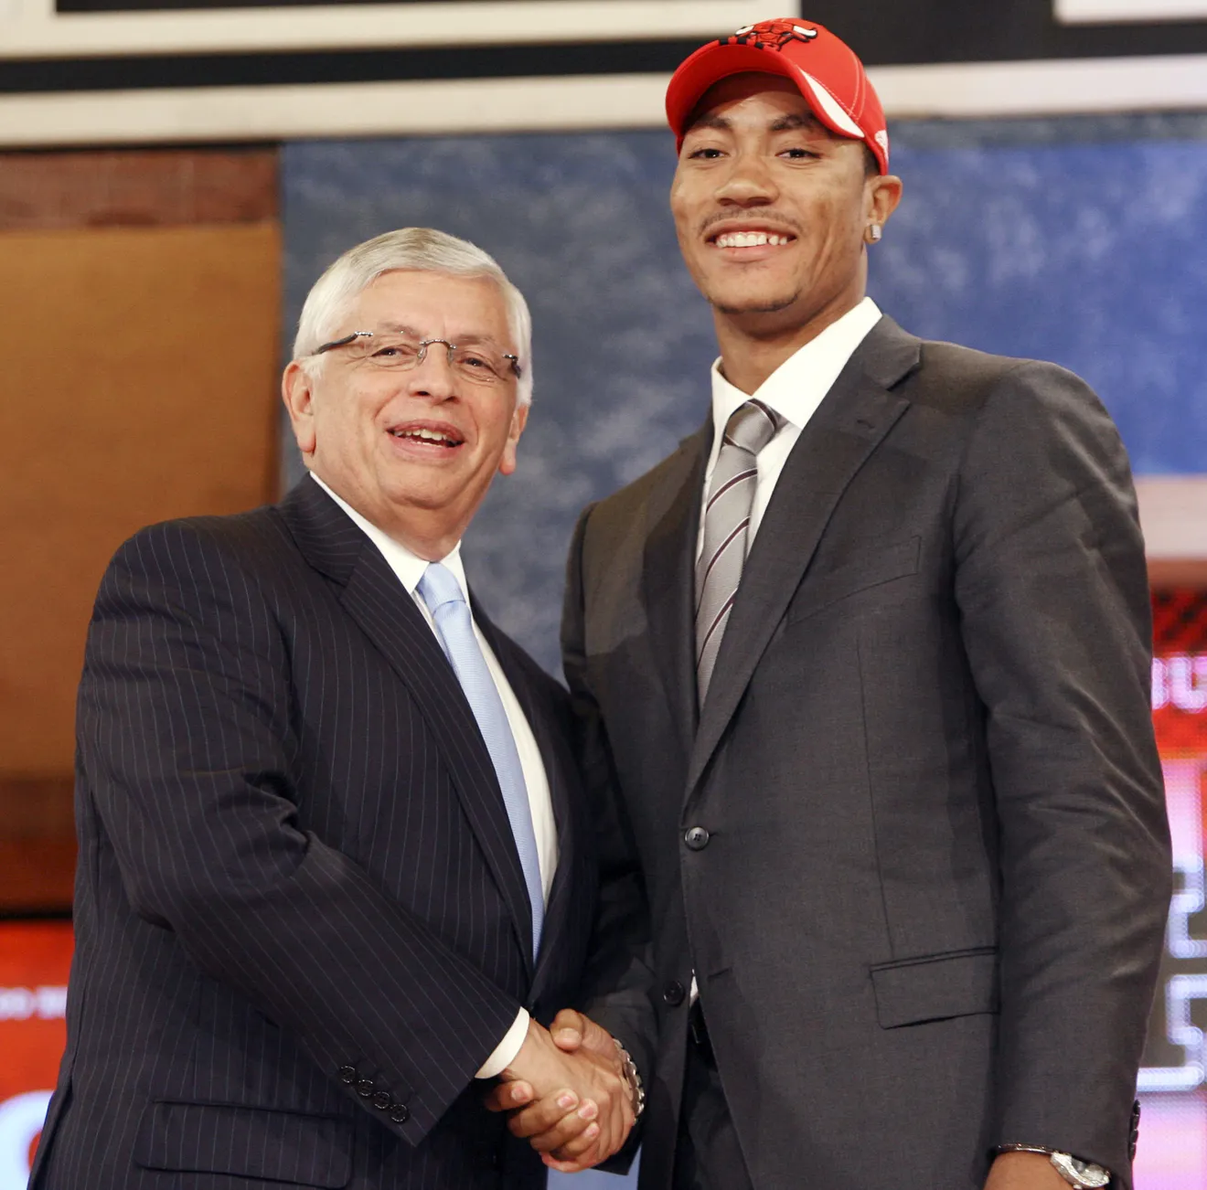
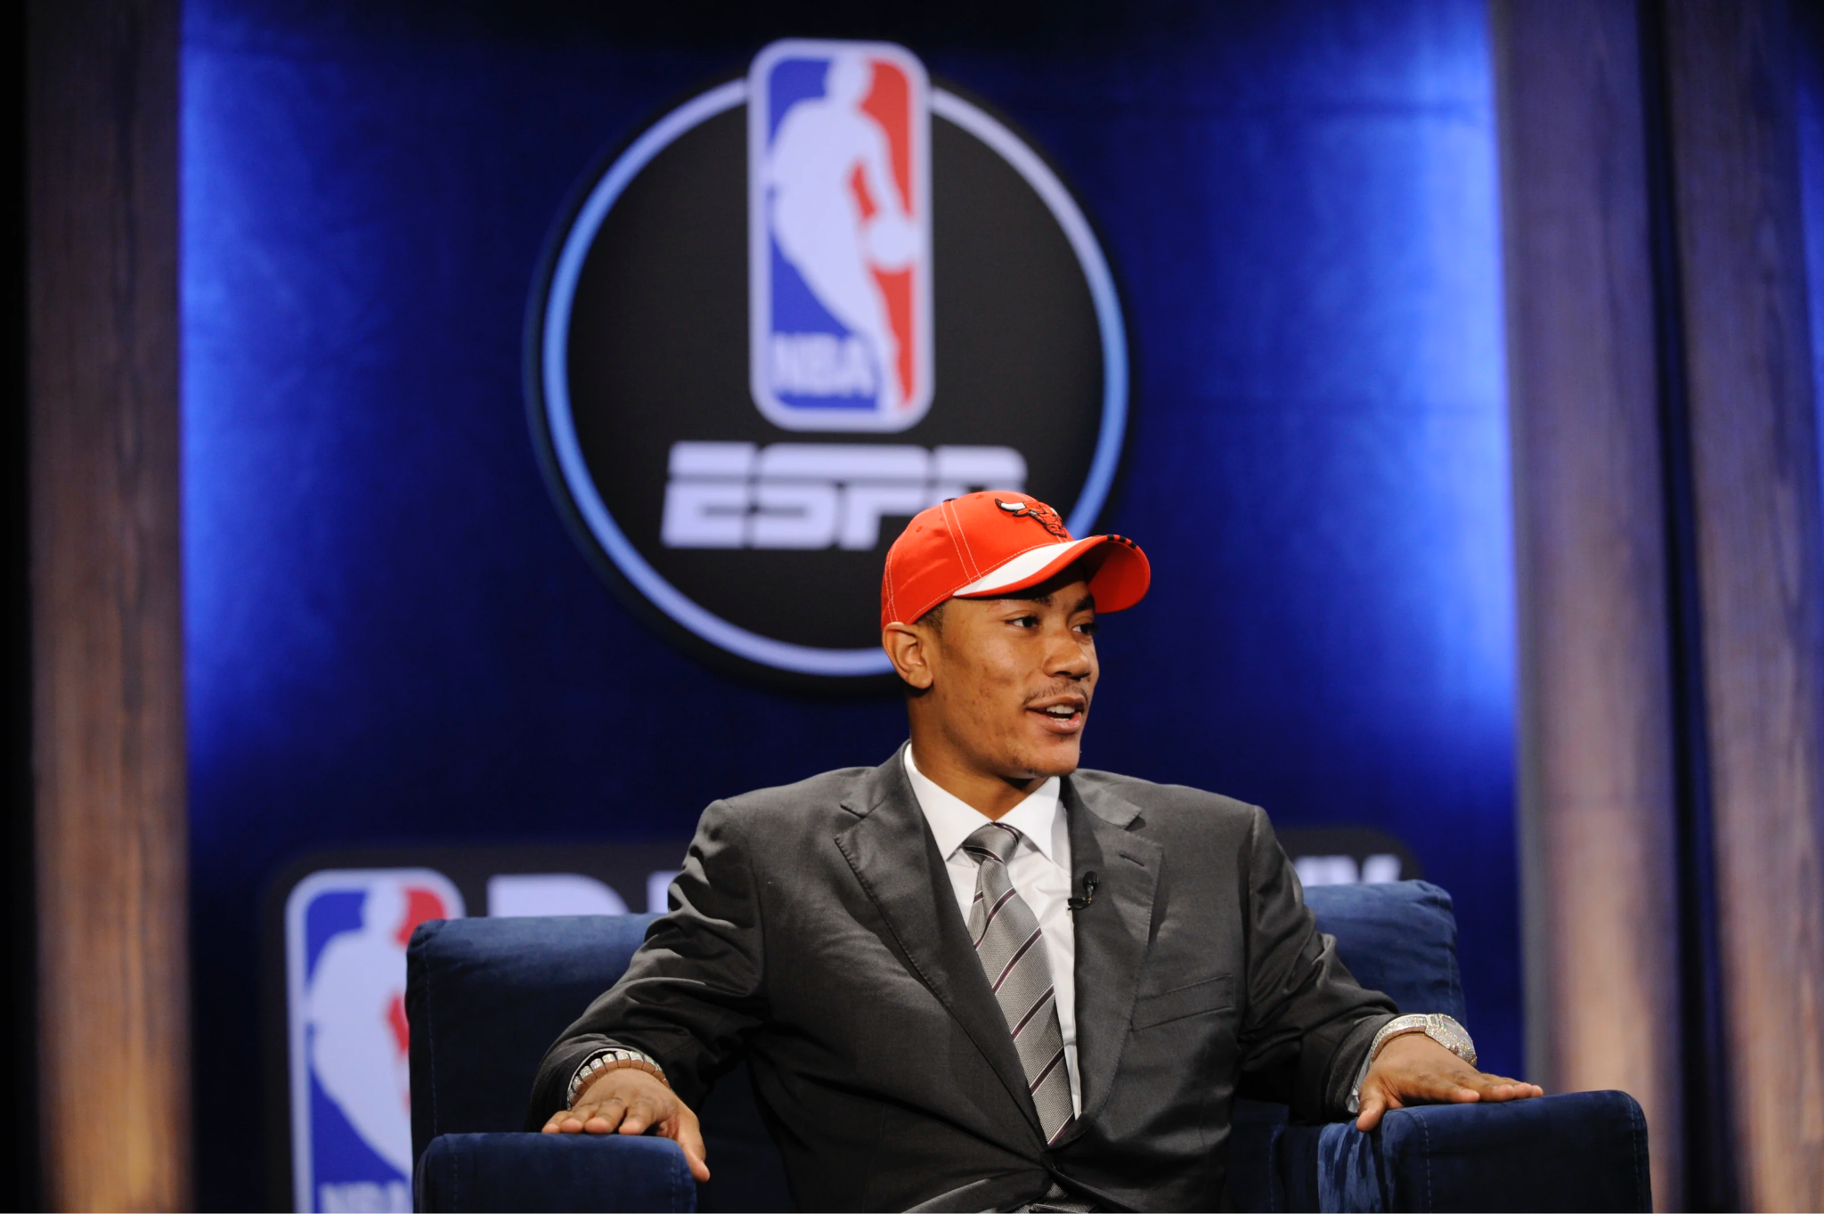
Notes:
The man you just saw dominating the court was Derrick Rose, the 1st pick of the 2008 NBA Draft by the Chicago Bulls.
As you just witness, he dominated the league from the moment he stepped foot on the court… but his rise in the NBA was cut short…

Slide 4
https://www.youtube.com/watch?v=jo1UlzDeY-o
Notes:
Injury Clip - Needs to be cropped to 10-15s

Slide 5
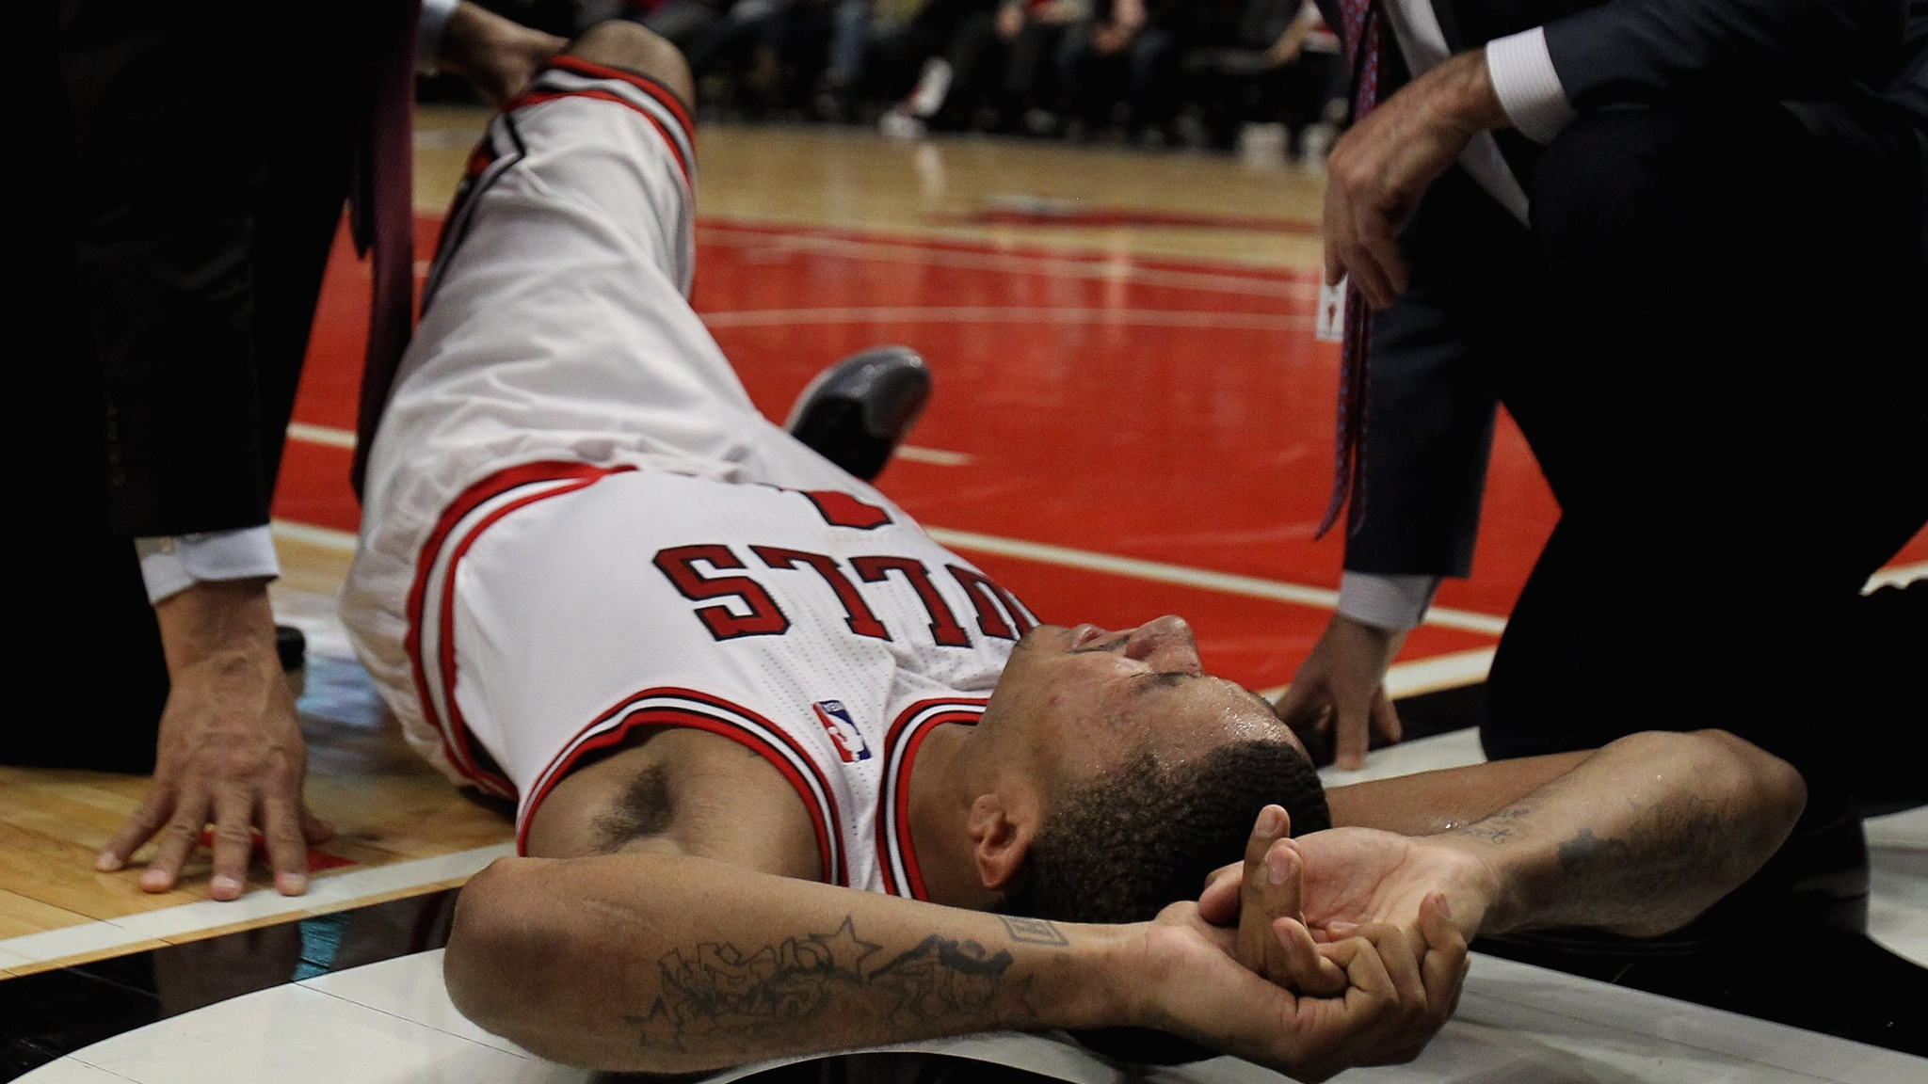
Notes:
Just two and half years into his career Rose suffered a massive knee injury tearing his ACL. While he was able to return to the court after a year and a half of rehab, his career was never the same and he never able to replicate the dominance he showed in his early years of play.
But… What if there HAD been a way for Rose to avoid that knee injury. What if there was a way that this generational talent could have better identified the risks involved in the play that was run and this could have all been avoided.
That’s our mission AT [Change Slide] PIEZSOLE…

Slide 6

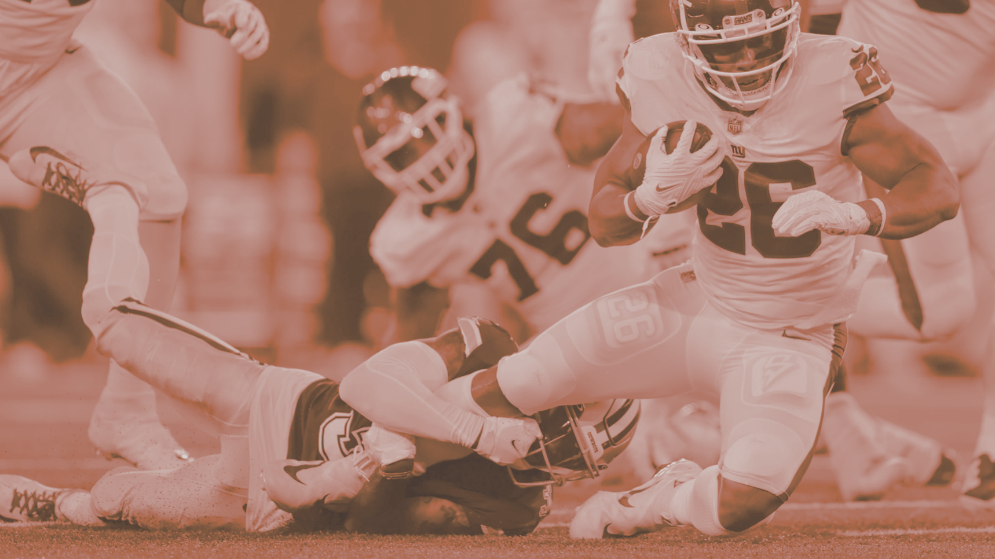
PIEZSOLE POWERED BY PIEZOELECTRICITY.
NEW PRODUCT MARKETING
THURSDAY, NOV. 10, 2022
Final Presentation
Melissa Chiou
Owen Jacobs
Venya Joshi
Annabelle Ju
Ananya Kommalapati
Soham Manjrekar
Stratis Papageorgakis
Dev Shah

Slide 7
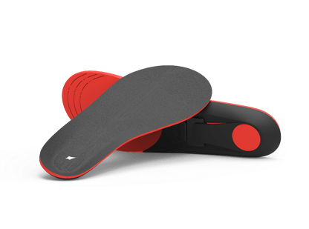

THE PIEZSOLE.
WITH PIEZSOLE, THE COMPETITION IS NO MATCH.
INJURY PREVENTION
A.I. informs users of injury risk
LIVE ANALYTICS
Detailed technical data at user’s fingertips
GAIN PERFORMANCE
Keeps users on the field longer
CONVENIENCE
No change in user behavior required
“A smart shoe insole that tracks an athlete's physical output.”
Images Courtesy of Mouser Electronics, Estec Group, Techtonics, Newark, Aillen, The Manual, Best Modules
Notes:
Dev
Our product is a smart shoe insole unlike any other. PiezSole uses a predictive algorithm to alert users to actions and tendencies that increase risk of injury, stopping injuries BEFORE they happen. Whether it’s
running plays in practice or just training Piezsole can alert users to behavior increasing their risk of injury to lower extremities like ankles & knees.
Alongside this cutting edge technology Piezsole delivers live analytics DIRECTLY to user’s fingertips allowing them to track their play quality in real time and make changes.
Piezsoles comprehensive systems allows users to perform at a higher level, keeping them on top of their quality of play while helping them prevent injuries -keeping them in the game for longer.

Slide 8
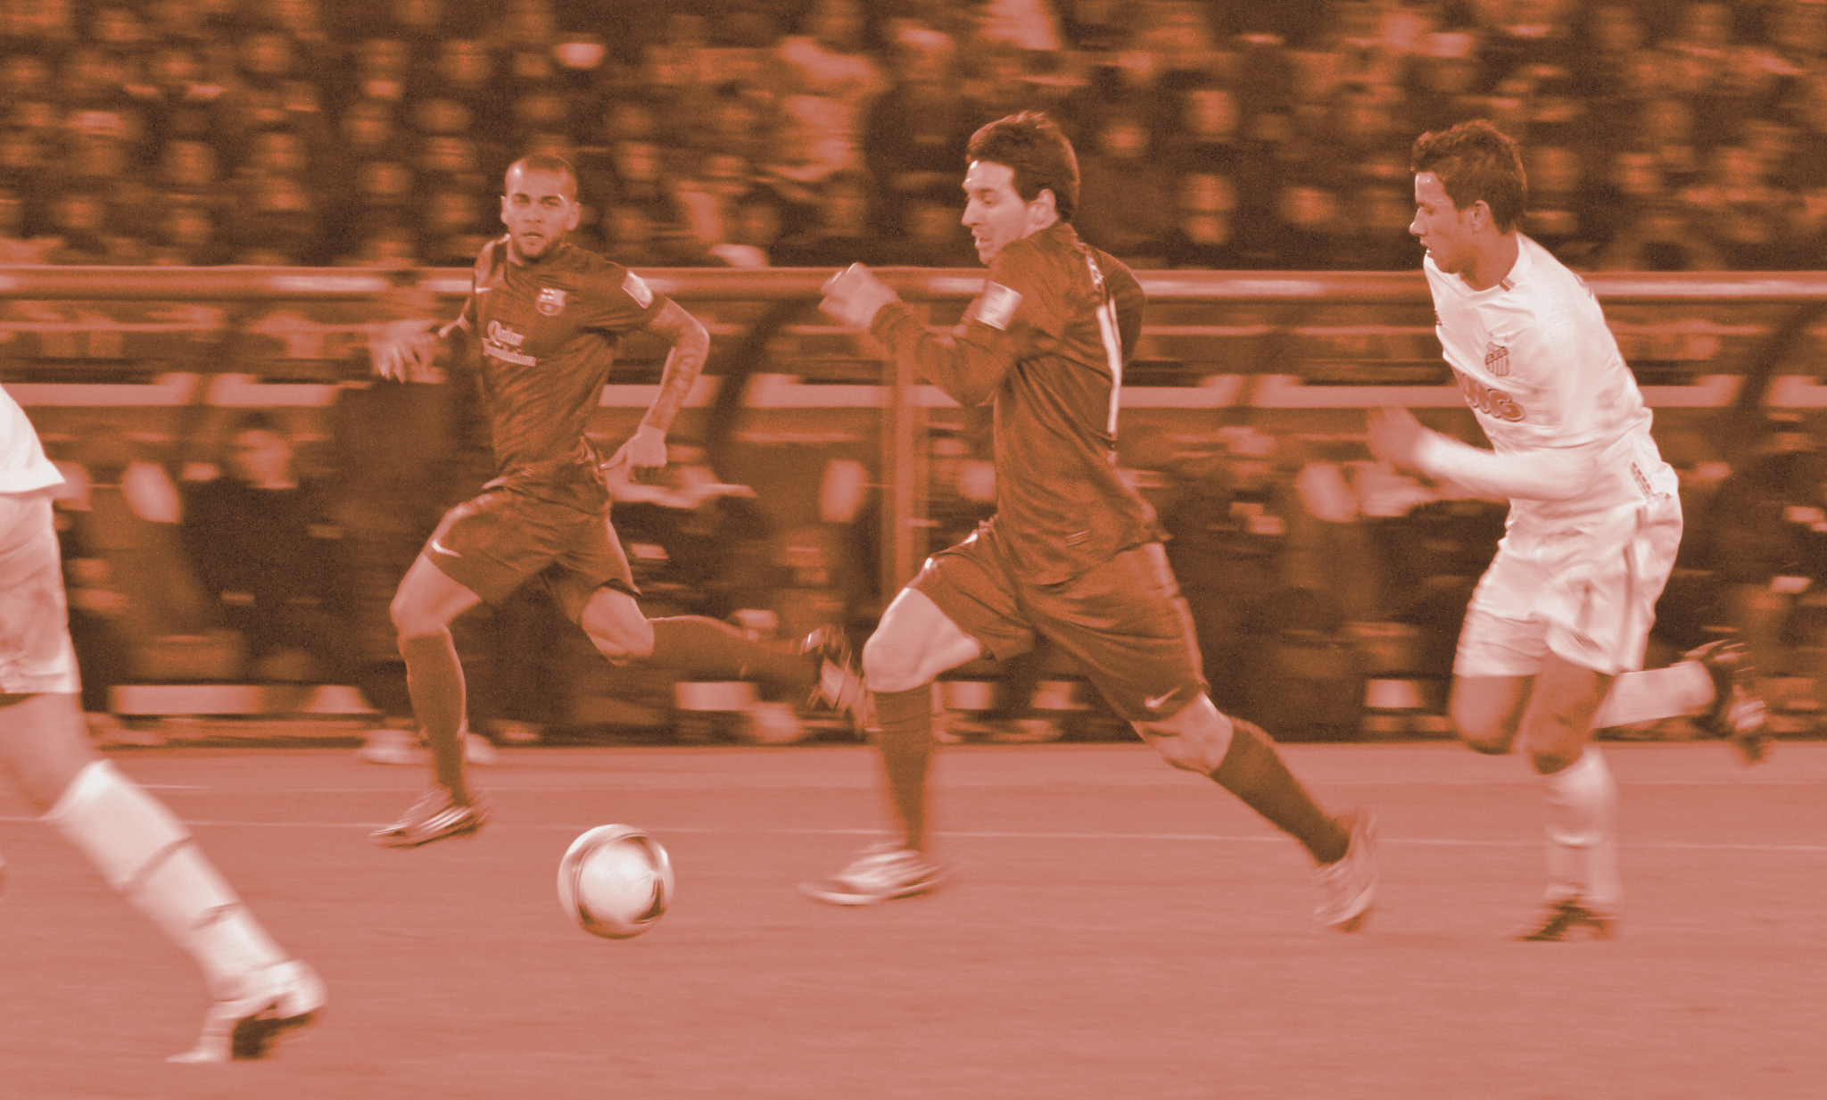
01.
PRODUCT SUMMARY

Slide 9

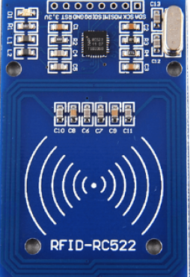
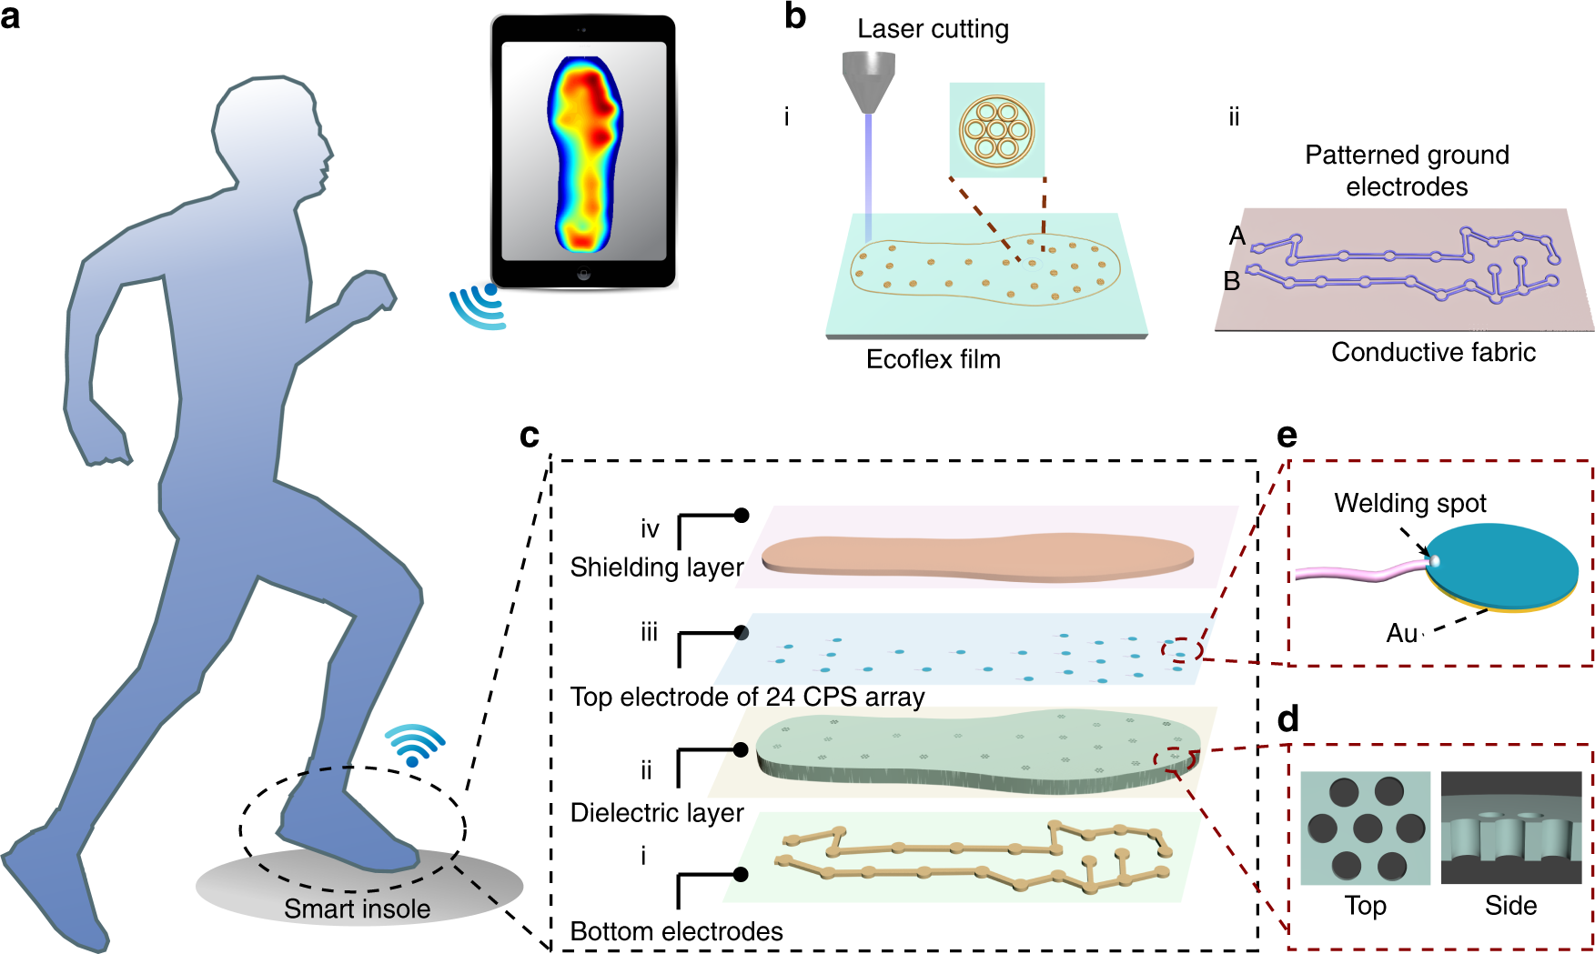
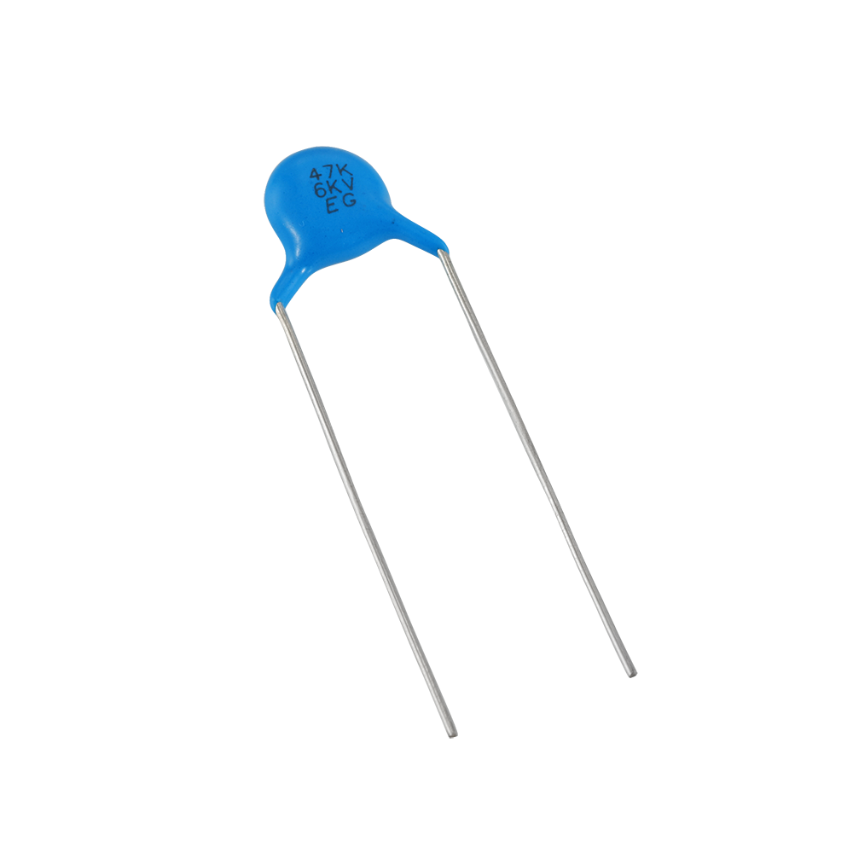
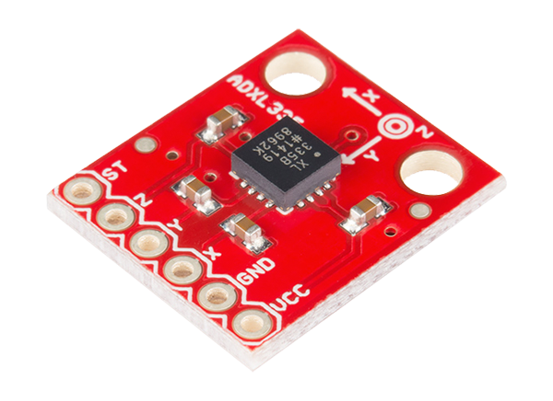
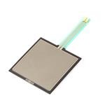
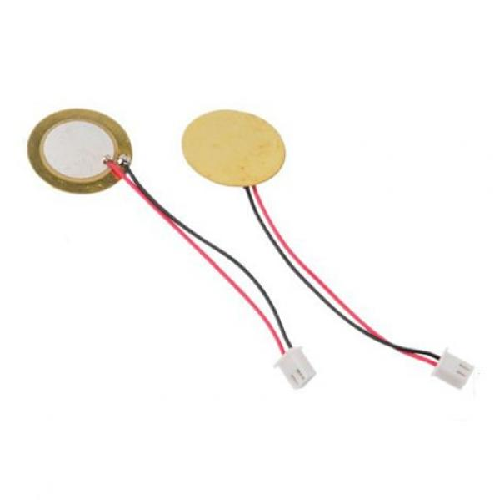
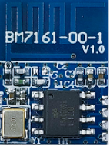
Product Description
PiezSole can:
Self-Charge
Measure Exerted Force
Track Player Position
Predict Cramps
Analyze Athlete Gait, Stride, Balance, Stability, etc
Notes:
Melissa
More specific breakdown of capabilities, PiezSole is self-charging as you use it so it will never run out of power when you need it, measures exerted force of the foot onto the shoe, tracks your position via GPS, predicts cramps in your muscles, and analyzes athlete gait, stride, balance, stability, and more to prevent injuries and optimize performance.

Slide 10
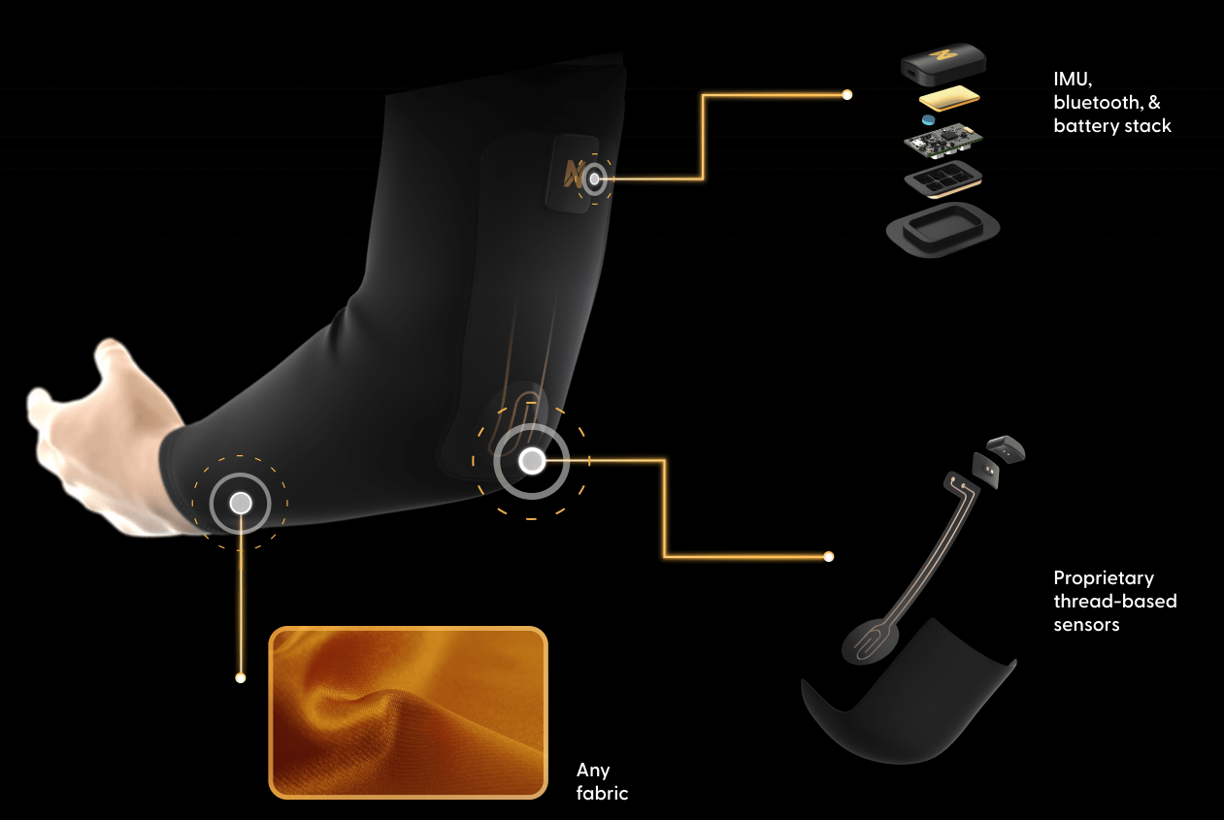
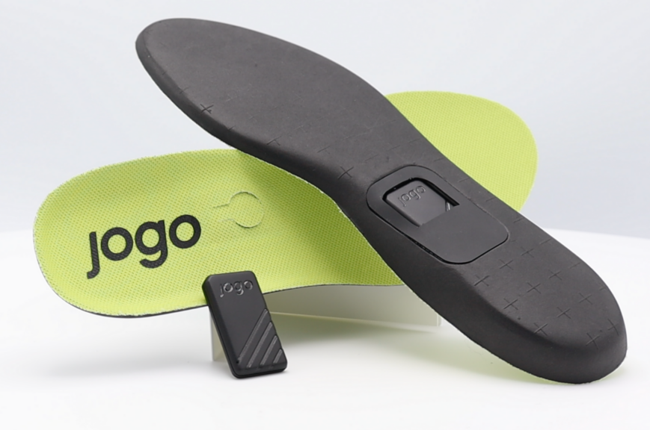
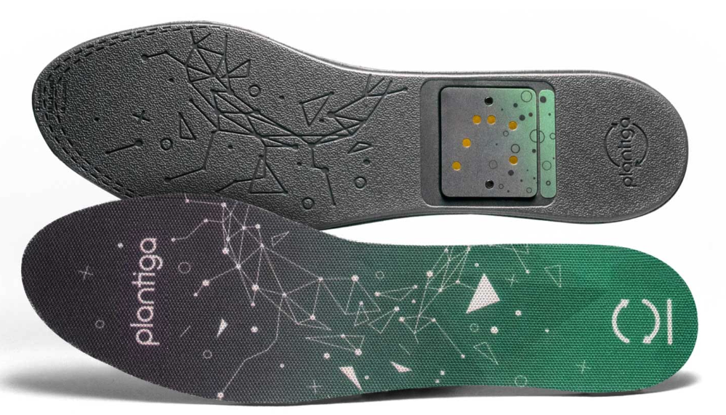
Competitor Analysis
Nextiles
Plantiga
Jogo
Images courtesy of Plantiga, Jogo, Nextiles
Notes:
Annabelle
Our major competitors are Plantiga, Jogo, and Nextiles: Plantiga and Jogo also produce data tracking insoles, and Nextiles creates data tracking fabrics.

Slide 11
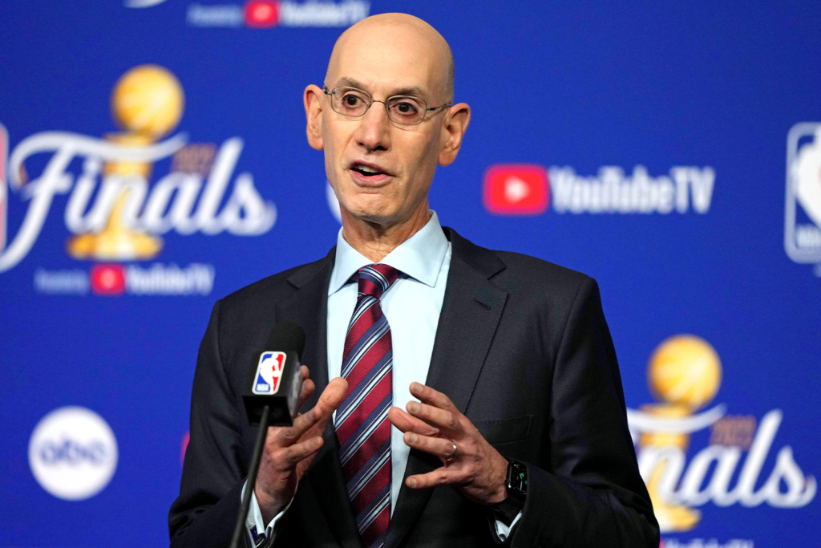
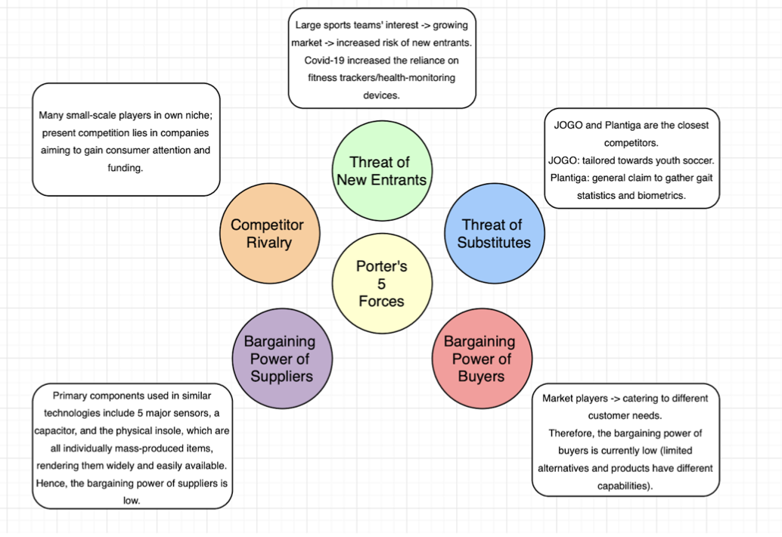

Industry Analysis
Wearable fitness trackers → 15.5% CAGR (2028)
NBA and NFL operations want more tech!
NBA Launchpad, NFL innovation
Image from NBA.com
Image from NFL.com
Notes:
Venya
In terms of industry analysis, we found that the wearable fitness tracker industry is growing rapidly, allowing us to interact with major leagues through the NBA LaunchPad and NFL Innovation.
Overall, in consideration of Porter’s 5 Forces, this is a viable and opportunity-filled market to enter.

Slide 12
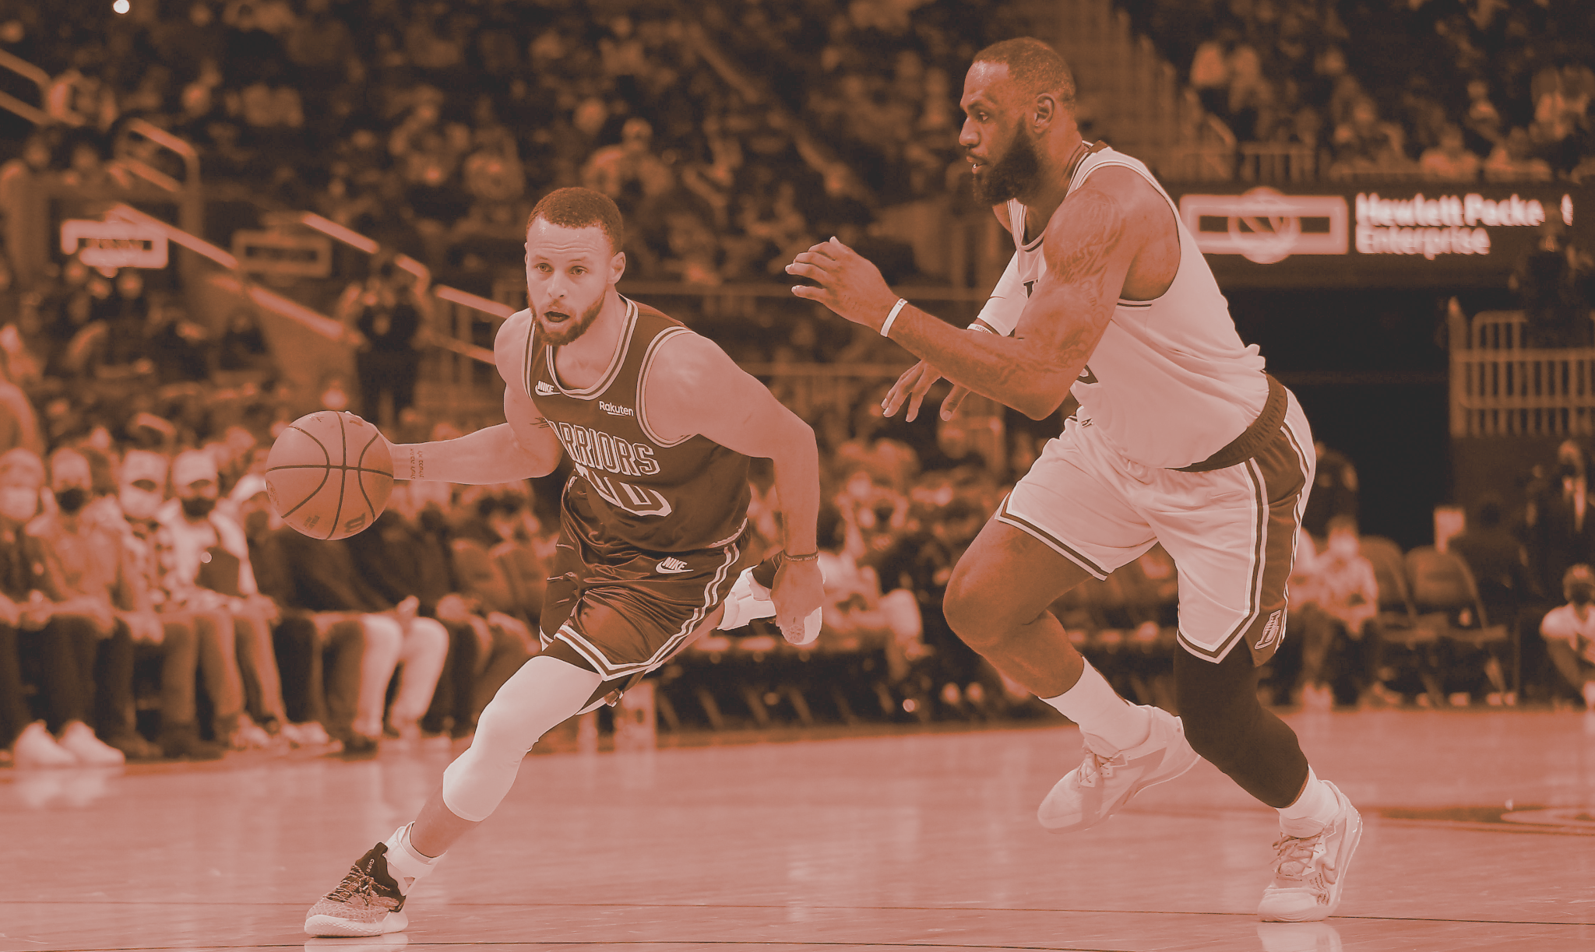
02.
STRATEGY
MARKETING

Slide 13

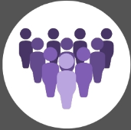
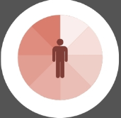

Market Segmentation
Demographic
Behavioral
PiezSole
Psychographic
Geographic
Age: 16-40
Gender: All
Occupation: requires athletic performance
Benefits: injury prevention, performance analysis
Usage Rate: daily
Brand Loyalty: better VALUE
Values: health, athletic performance
Lifestyle: active
Psychological: self-driven, goal-oriented
Global, based in the U.S.
Notes:
Melissa
For a market segmentation breakdown
Our target market will have a demographic of ages 16-40 as that appears to be the age range where people are more serious about their physical activity, all genders, and their occupation requires excellent athletic performance as the Piezsole is an in-depth analysis tool that would be most applicable to people whose livelihoods depend on their athletic ability.
From a psychographic standpoint, we are looking at individuals who value their health, athletic performance. They lead active and health conscious lifestyles and have self-driven, goal-oriented mentalities.
As for the behavioral analysis, our consumers would be people who are seeking methods for injury prevention and performance analysis on an everyday basis. Our brand is worth sticking with because we provide better functionality for the same price, which results in better value.
Lastly, our geographic scope will be global, as there are people of this description all over the world, but our company will be based in the U.S.

Slide 14

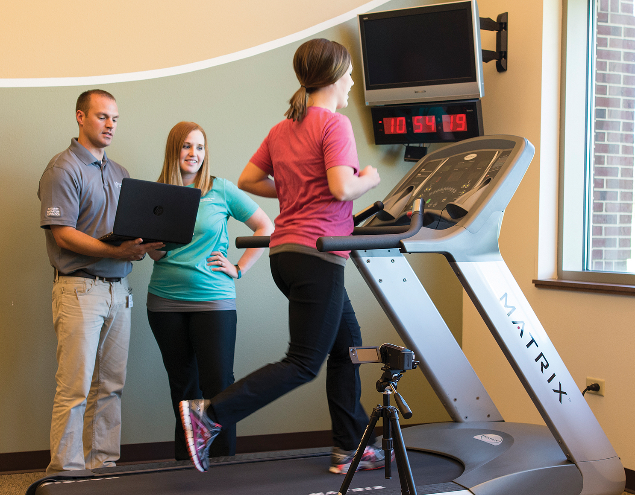
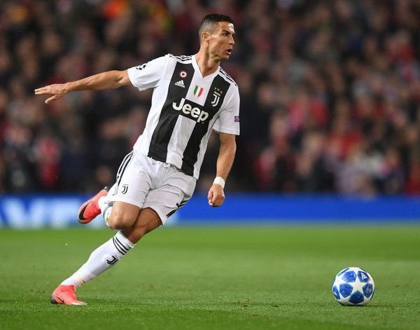
Target Market Evaluation
Military
Medical
Sports
Measurable
Reachable
Sizable
Coherent
Manageable
Measurable
Reachable
Sizable
Coherent
Manageable
Measurable
Reachable
Sizable
Coherent
Manageable
Notes:
Soham
We can now start to evaluate the markets that naturally come forward given our segmentation criteria .
All 3 target markets are measurable: military and medical are multi trillion dollar industries, while the sports industry is only a few hundred billion, however, if we look at the investment in injury prevention/training/performance tracking, we see that the military and medical industries spend $2 and $4 billion respectively while the sports industry spends upwards of $12 billion.
Reachability wise looking back to our interim summary we see that the sports industry has programs like NFL innovation and NBA Launchpad that are actively interested in this technology, whereas in the military funding is more reserved for research in performance augmenting technologies and in the medical industry, specifically in physical therapy, less than 10% of patients are looking for podiatry related solutions
All 3, markets are sufficiently large to be profitable and are expected to grow by a few billion dollars by 2025
The medical and military industries have many sub sectors and specific types of customers/consumers so they are not coherent, while in the sports industry there
Finally
Purchasing Power and Profitability
Globally, The military is a $2.1 trillion industry, of which $1-2 billion is spent on training technology encompassing products like ours
The Medical industry is approx. $3 trillion of which only $4-5 billion is spent on rehabilitation/ injury prevention products like ours
Finally, The Sports Industry is a $350 billion dollar industry of which $12.2 billion is spent on sports technology
We see that even though the sports industry is smaller than the military and medical industries as a whole, the most amount of money available is in the sports industry
Typical Customer
For the military, Military purchaser looking to better train their personnel. Typical user would be someone enlisted in the army undergoing training
For the medical industry, Hospital administrators with a Physical Therapy dept. Or independent clinics that offer treatment. For patients facing podiatry problems or patients who want to prevent podiatry related injuries
Finally, for sports industry, Athletic Organizations (NBA, NFL, etc.) or teams within those organizations.With users being elite athletes looking to improve their performance
Forecast Market Potential per segment
Expected to reach $12 billion in 2022, and is projected to grow at a CAGR 12. 23% to reach $5 billion by 2027
Expected to remain stable/ continue to recover from drop during Covid pandemic ~$2-3 billion
Expected to expand at a compound annual growth rate (CAGR) of 19.6% from 2022 to 2030 ~15 billion
Now to evaluate target markets,
All 3 are measurable however, the market with the most money on the table is the sports industry
The

Slide 15
Positioning
STOP INJURIES BEFORE THEY HAPPEN, WITH PIEZSOLE.
DIFFERENTIATING OURSELVES IN THE MARKETPLACE
INJURY PREVENTION
A COMPREHENSIVE VALUE PROPOSITION:
LIVE ANALYTICS
GAIN PERFORMANCE
CONVENIENCE
Notes:
Dev
With our target market in hand, we can move forward to our product positioning
Fundamentally Piezsole holds a strong advantage with our injury prevention technology over major market competitors
This technology can be
STOP INJURIES BEFORE THEY HAPPEN, WITH PIEZSOLE.

Slide 16

03.
MIX + PLAN
MARKETING

Slide 17
Pricing Strategy + Tactics
Pricing Objective: Sales Maximization
Customer Demand: Slightly Inelastic
Estimated Costs:
Fixed: $500K
Variable: $70-$80 per pair
Competitor Prices:
Plantiga: $200, $30 per month subscription
Jogo: freemium + 10€/month+
Nextiles: price dependent on use case, material, and added sensors
Pricing Method: Competitor based
FINAL PRICING:
Presell:
Individual: $200, $25/month
Bulk: $160 per, $200/month
Retail:
Individual: $225, $30/month
Bulk: $180 per, $250/month
Notes:
Annabelle
In terms of pricing strategy, our objective is sales maximization since we want to focus on establishing our customer base and maximizing revenue for the first year.
Our customer demand is slightly inelastic since there is low availability of other similar products, and Piezsole would be a long term investment into athlete health.
For estimated costs, our fixed costs should be around $500 thousand dollars based on averages on numbers from the manufacturing industry. (since we plan to manufacture our own products)
Since our major competitors are all private companies, we don’t have much data on their prices and offers. The most concrete numbers we have are from Plantiga, which we used to set our competitor based pricing.
So for our final pricing rates: we have different rates for our presell period vs the normal retail price -- and we have different rates for individual consumers vs for bulk orders for organizations and such
Bulk orders will be for 20 units or more
So final retail price will be first for individuals ($225 for the insole and $30 per month software subscription), then for bulk orders ($180 per pair of insoles and $250 per month for software subscription for 20 or more units) -- and monthly software subscription bulk cost does not change with increased units, which will encourage organizations to buy more units

Slide 18
Channel Strategy + Tactics
Manufacturer -> Retailer -> Consumer
Walmart, Academy Sports and Outdoors, Big 5 Sports, etc.
Wholesaler -> post - establishment
Increase efficiency, delineate work, develop network.
Dependent on pricing and promotional strategies.
Promotional: packaging style, pre-selling outlets, etc.
Pricing: individual vs. bulk-orders, etc.
Notes:
Ananya
For our channel strategy, we have decided to structure it as beginning with the manufacturer, then moving onto the retailer, and finally ending with the consumer. Some retailers that we would like to sell our product in would be Walmart, Academy Sports and Outdoors, and Big 5 Sports to name a few. However, once we have established more stable footing within the market and the product demand warrants it, we could introduce a wholesaler into our channel strategy to further ease the process. Moving on, making use of a distribution channel would increase efficiency, allow Piezsole to delineate work, while also developing a valuable network for future needs. Finally, the channel strategy is also dependent on and related to both the pricing and promotional strategies. With regards to promotional, the packaging style as well as pre-selling outlets would impact the retailer level whereas with the pricing, the individual and bulk-order pricing would impact the manufacturer level. Overall, our channel strategy is set-up to allow our product to successfully reach consumers but will be modified as per market and demand changes.

Slide 19
Promotion Strategy + Tactics
Purpose: Pioneering and Persuading
Cohesive Storytelling:
Social media
Programmatic advertising
Athletic endorsements
Empowering Athletes:
Sponsoring athletic events
Sports publications
Personal selling
Pushing Piezsole:
Preselling
Distinguishable packaging
Capturing comprehensive feedback
Piezsole utilizes a love and passion for sports and personal improvements
Notes:
Venya
Promotions are an integral part of branding and sales, and Piezsole plans on taking a multi-pronged approach to pioneer and persuade consumers in regards to our insole and story. We want an aggressive and coherent message interwoven in the lives of our consumers. Our first aim is to center on cohesive storytelling. By incorporating the human story in our social media, programmatic advertising, and athletic endorsements, we hope to tell stories of our people, sports, and passion. Our second approach is to empower athletes through sponsoring athletic events, sports publications, and having representatives personally promote our product to coaches and talent agents. Finally, we hope to be able to push and deliver with Piezsole through our pre-selling pursuits, distinguishable packaging, and capturing comprehensive feedback from our consumers to improve and accommodate to create the greatest improvements. Ultimately, our brand makes use of emotional and rational appeals in hopes of utilizing a love and passion for sports and personal improvements.

Slide 20
Roll Out Plan: TIMELINE
Q1
Q2
Q3
Q4
Months 1-3
“Buzz”
Months 4-6
“Distribution”
Months 7-9
“Growth”
Months 10-12
“Expansion”
Primary research -> test marketing
Social media launch; website preselling/preordering
Personal selling: coaches and talent managers
Broadcast human story
Get retailers on board
Attain Sponsorships
Funding Competitions
Maintain Promotion Efforts
AIDA
Receive + Implement Consumer Feedback
Maintain Promotion Efforts
Add Distribution Intermediaries
R&D for Complementary Goods
Shift to Asymmetric Pricing
Maintain Promotion Efforts
Notes:
Q1 + Q2: venya
We’ve created an overview for our implementation plans for the first fiscal year of Piezsole’s operations
Quarter one is focused on creating buzz where a lot of our resources will be invested in promotion and extra market research
We want to initially test market our product to gain understanding of our performance while also focusing on establishing our social media presence, garnering presales on our website, and personally reaching out out to league coaches.
Additionally we want to kick off our storytelling to establish our human-centric brand and creating a relationship with consumers
In quarter 2, we plan to get sporting good retailers to carry Piezsole, explore new avenues of capital, and maintain our promotional efforts and branding
Q3: ananya
For quarter 3, as per the AIDA model, we should see increased product awareness, both from regular consumers and sports teams, leading to overall increase in orders and purchases. We will also gather feedback from consumers for improvements as well as complementary product designs, and maintain our social media presence along with promotional content from professional athletes.
Q4: annabelle
Finally for the last quarter, we will focus on expansion: adding distribution intermediaries, working on R&D for complementary goods.
Also implement asymmetric pricing in the long term to make long term subscriptions more attractive and make sure our customer base remains stable.

Slide 21

04.
ANALYSIS
FINANCIAL
Notes:
Stratis
I’m Stratis & I’m Owen, and we will give a financial analysis of our product

Slide 22
Financials
What we’re seeking…
PiezSole’s seed funding totalling $3M
Plantiga → $1.5M & Nextiles → $5.3M
PiezSole’s Financial Plans
Aggressive annual marketing budget → $90k/year ($450k in 5 years)
R&D spending, salaries, space, etc…. → $410k/year
TOTAL FIXED COSTS = $500k/year
Notes:
Stratis
We are seeking $3 million dollars in seed funding for our proposal and we will explain why this number is reasonable. For comparison, our competitors like Plantiga and Nextiles generated $1.5 and $5.3 million dollars in initial investments showing that our offer is in the ballpark. We plan on having an aggressive annual marketing budget of $90 thousand a year as we are a startup who wants to expand our brand image and we expect to spend roughly $410 thousand dollars a year on R&D, salaries, space, etc. This brings our total fixed costs to be $500 thousand dollars a year.

Slide 23

Financials
Variable Costs:
Bill of Materials:
Flexible Circuit Board: $7.50
RFID Module: $6
Accelerometer: $4
Piezoelectric Generator: $6
Bluetooth Transmitter: $3.50
Supercapacitor: $7
Pressure Sensor: $3
Material for Shoe Insole: $1.75
Overhead Costs (manufacturing) : $5/unit
Distribution Costs: $5/unit
Other Expenses & Overheads: $24.75/unit
Estimated cost of 1 unit:
$73.50
$38.75/unit
Notes:
Stratis
In terms of variable costs, the bill of materials costs $38 dollars and 75 cents a unit. Our overhead and distribution costs will be $5 a unit and other expenses and overheads will be $24 dollars and 75 cents a unit. This brings the estimated cost of 1 unit to be $73 dollars and 50 cents.

Slide 24



Financials
Based on these estimates…
Margin = (($200 - $73.50)/($200))*100 = 63.3%
Profit maximization + competition
5 year period, customer lifetime
Fixed costs: $500,000/yr
Variable costs: $73.50/unit
Revenues: 60 months * $25/(unit*month) + $200/unit
BEP = 1 → n = 1,538 units
Notes:
Owen
Based on these estimations for fixed and operating costs, we are able to calculate a few figures of interest. First, with knowledge of our upfront price of 1 piezsole, we can calculate the margin per sale. Assuming it costs $73.50 to produce 1 piezsole, selling it at $200 would mean we are taking a 63.3% margin on sales. Additionally, using the breakeven point formula, we can calculate the number of units necessary to return fixed and variable costs associated with producing units and operating out business. Estimating a 5 year period and 5 year customer lifetime, and using the individual retail pricing ($200 upfront, $25/month*unit), 1538 units would need to be sold to break even over this time frame.

Slide 25

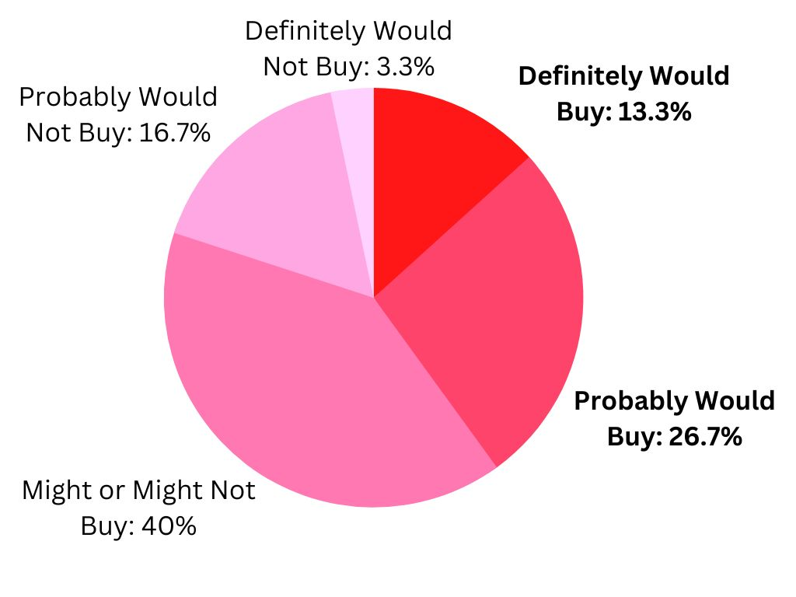
Market Share & Projections
NFL: 1696 players
NBA: 450 players
MLB: 1088 players
Top 5 European Soccer Leagues: 2606 players
5,480 Athletes
Assuming 40% of Market Capture:
2192 sales
Assuming 30% of Market Capture:
1644 sales
Notes:
Stratis
By only looking at the NFL, NBA, MLB, and top 5 European soccer leagues, there are 5,480 athletes. We used our primary data collected in the ATAR model showing that we could assume to capture 40% of the market meaning we would have 2192 sales. However, because we know that people overestimate in surveys, even if we cut 10% of our market capture, we would still sell 1644 products which is still above our Break-even point, and this is not even taking into account other leagues or individual use.

Slide 26
5 Year Projections
Revenue:
Assuming 2192 units sold initially
5 year customer lifetime
Revenue = 2192 units ( $200/unit + 60 months * $25/month*unit )
= $3,726,400
Profit:
Profit = Revenue - Cost of sales
= $3,726,400 - [ ($2,500,000) + 2192 units ( $73.50/unit ) ]
= $1,065,288
Notes:
Based on primary data presented in the previous slide, we are able to estimate profits and revenue over a 5 year period based on previous assumptions. Revenues could total $3.7M, while profits could be close to $1M dollars.

Slide 27
Assumptions & Contingency Plan
Financial and market share
40% adoption rate
UIUC athletes → UIUC students
Adoption based on MLB, NBA, NFL, 5 sizeable professional soccer clubs
5 year customer lifetime
Manufacturing, distribution, other costs & taxes based on Nike shoe
Contingency plan
“Buzz” period → primary data, better estimates → better figures
Changes in funding → scale up or down
Assumptions (mix, strategy) challenged → pivot!
Notes:
While working on financial analysis, a number of assumptions were made in order to be able to actually arrive at figures. We attempted to gather primary data from athletic teams here at U of I, but were unsuccessful. We resorted to convenience sampling of U of I students to gather purchase intent data. It is historically noted that consumers are often poor reporters of their own behavior, thus a 40% adoption rate among our target market may be a high estimate. Additionally, we based financial calculations on assumptions that we can obtain ~$3M in venture capital, and a 5 year customer lifetime. Each of these assumptions add uncertainty to the figures we have arrived at.
Our contingency plan will be quite dynamic in nature. We plan to spend the ‘buzz’ period (1-3 months) gathering primary research and promoting the piezsole. This period will be relatively low cost and will not require massive funding. From this time we will be able to gather much more accurate figures in terms of purchase intent and adoption, and much more sensible financial estimates will be arrived at. We may find that key assumptions in our marketing strategy and mix are challenged; we will not hesitate to pivot in any direction which concrete data indicates that we will find more success.

Slide 28
CONVENIENCE.
INJURY PREVENTION.
PERFORMANCE.
PIEZSOLE.
Notes:
Stratis
We will deliver convenience, injury prevention, and performance to our customers. This is PiezSole, and we are looking forward to working with y’all.

Slide 29
Thanks!
Questions?
Notes:
We appreciate your consideration. Now we’d like to open up the floor for questions.

